Slide 1
Analysis of Particle Filtering as an Effective Approach to Handling Concept Drift in Streaming Data
Tegjyot Singh Sethi
https://github.com/tegjyotsingh/Incremental-Classification

Slide 2
Streaming Data and Concept Drift
Database
Training data (Labeled data)
Generate
Streaming data(Unlabeled data)
Classifier
Predicted Classes

Slide 3
Streaming Data and Concept Drift
Database
Training data (Labeled data)
Generate
Streaming data(Unlabeled data)
Classifier
Predicted Classes
Challenges in Stream Mining
Scalability and Response Time
Robustness
Concept Drift

Slide 4
Streaming Data and Concept Drift
Database
Training data (Labeled data)
Generate
Streaming data(Unlabeled data)
Classifier
Predicted Classes
Concept Drift: P_{t} (y| x_{i}) ≠ P _{t+1}(y| x_{i}).
Challenges in Stream Mining
Scalability and Response Time
Robustness
Concept Drift

Slide 5
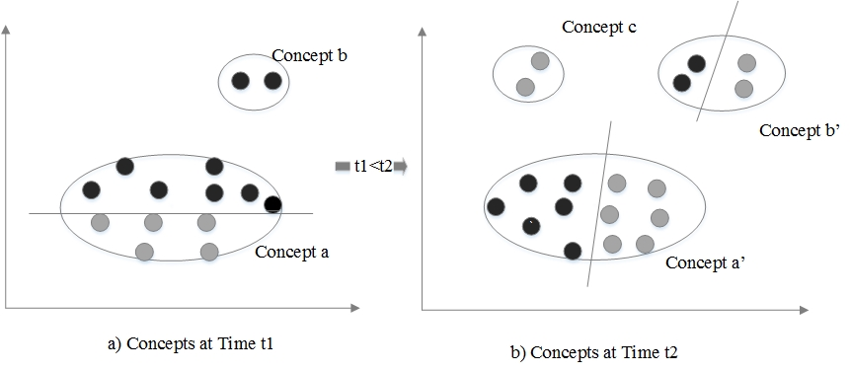
Streaming Data and Concept Drift
Concept Drift: P_{t} (y| x_{i}) ≠ P _{t+1}(y| x_{i}).

Slide 6
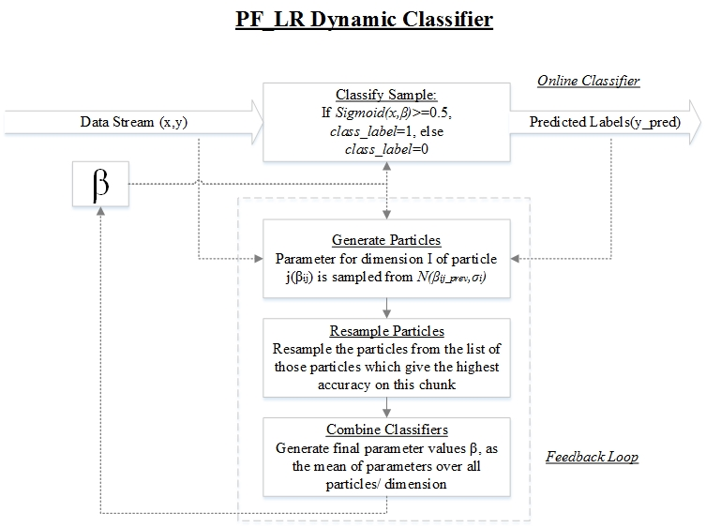
Particle Filtering for Stream Classification

Slide 7
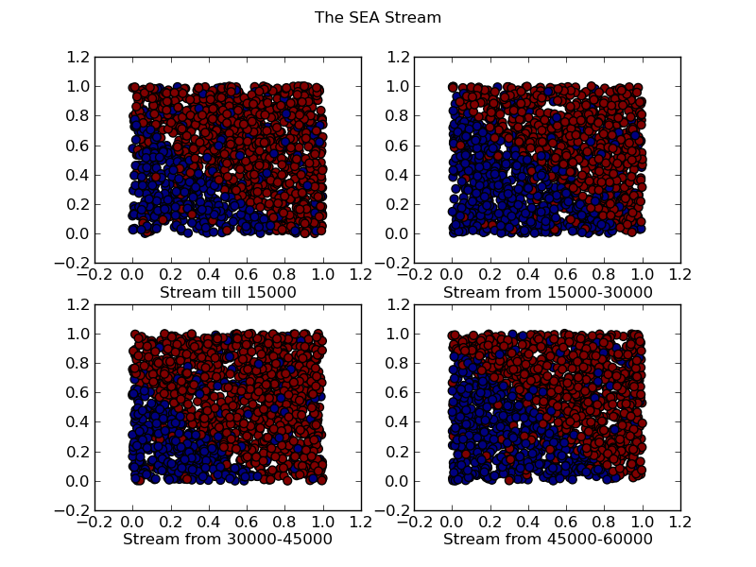
Experimentation : Datasets Used
> SEA Stream:

Slide 8
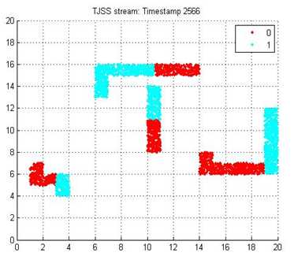
Experimentation : Datasets Used
> TJSS Stream:

Slide 9
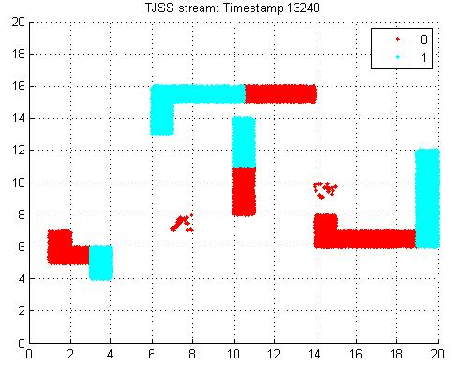
Experimentation : Datasets Used
> TJSS Stream:

Slide 10
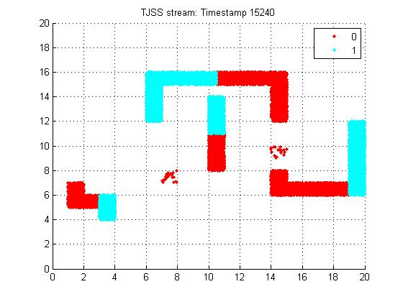
Experimentation : Datasets Used
> TJSS Stream:

Slide 11
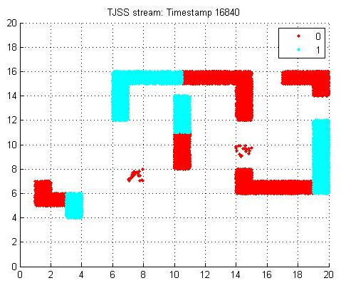
Experimentation : Datasets Used
> TJSS Stream:

Slide 12
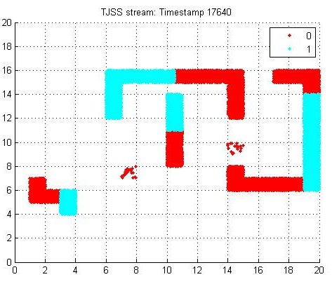
Experimentation : Datasets Used
> TJSS Stream:

Slide 13
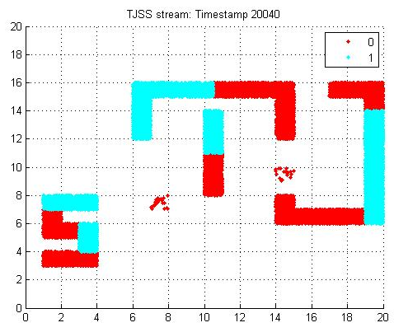
Experimentation : Datasets Used
> TJSS Stream:

Slide 14
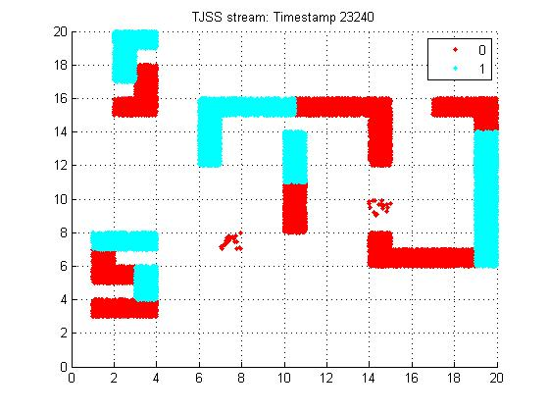
Experimentation : Datasets Used
> TJSS Stream:

Slide 15
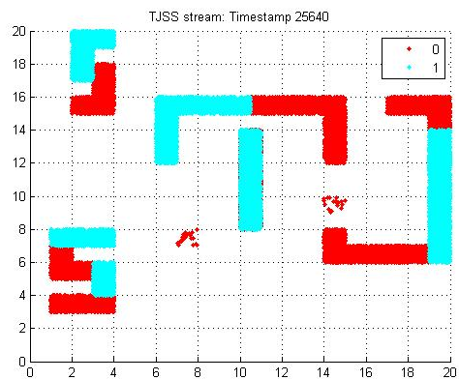
Experimentation : Datasets Used
> TJSS Stream:

Slide 16
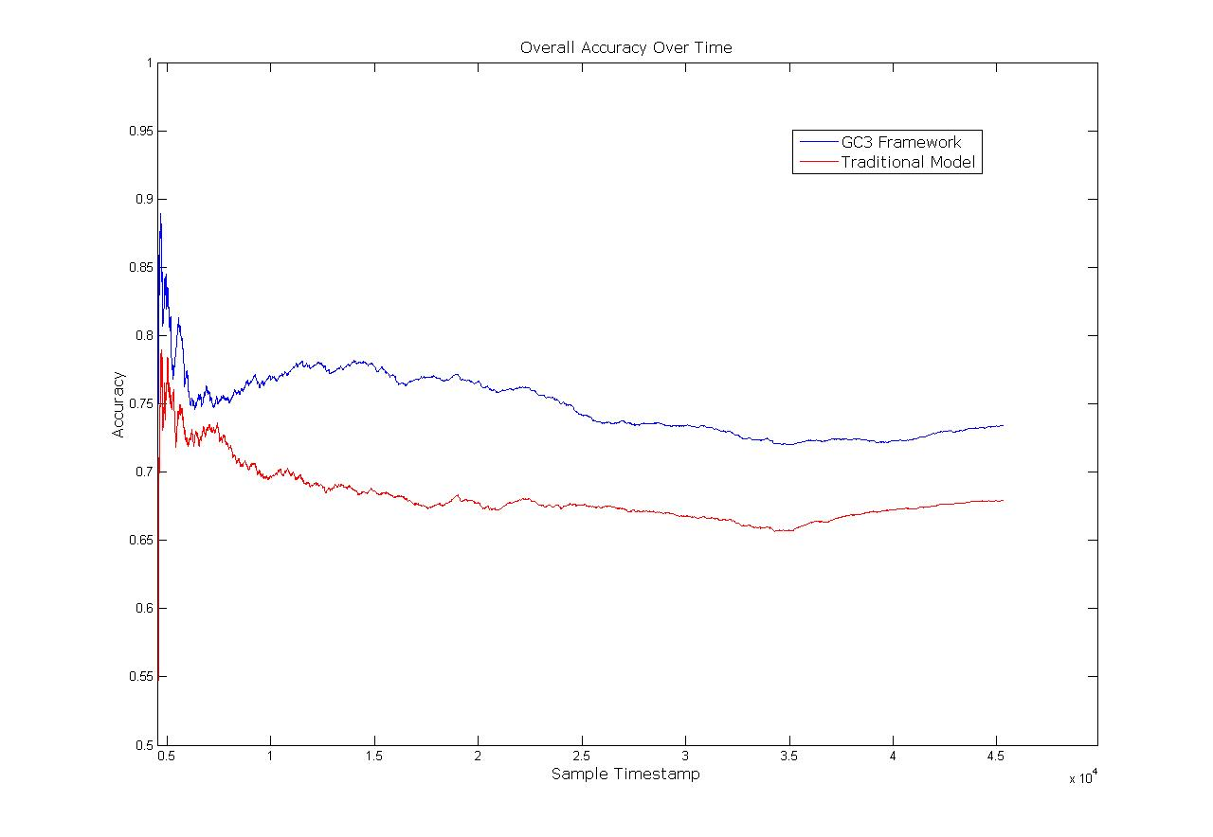
Experimentation : Datasets Used
> EM Stream:

Slide 17
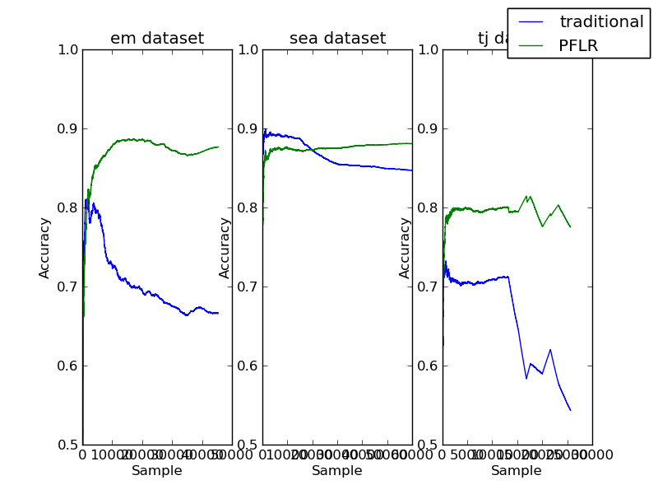
Experimentation : Results

Slide 18
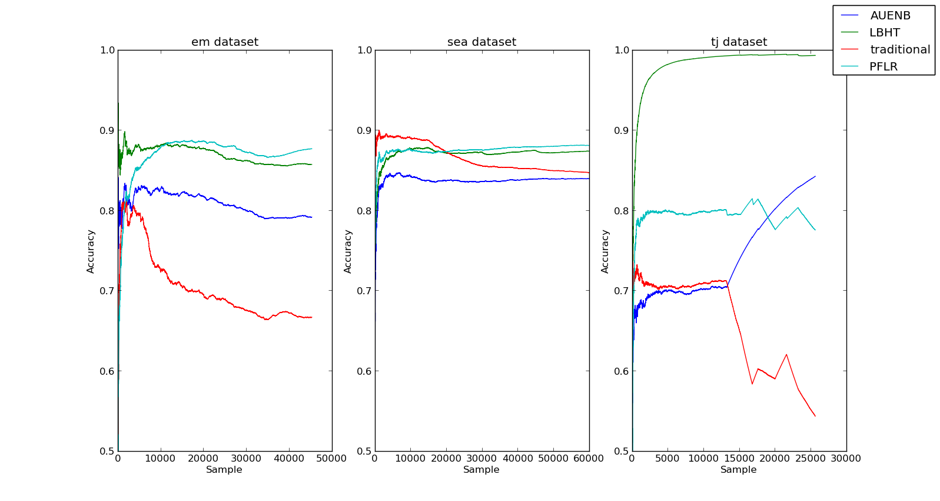
Experimentation : Results

Slide 19
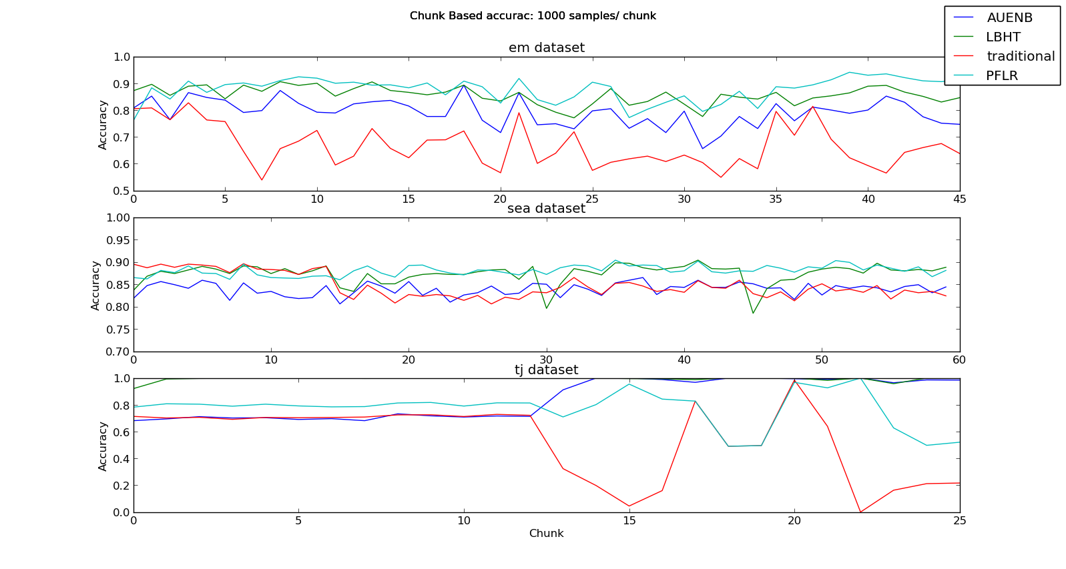
Experimentation : Results

Slide 20
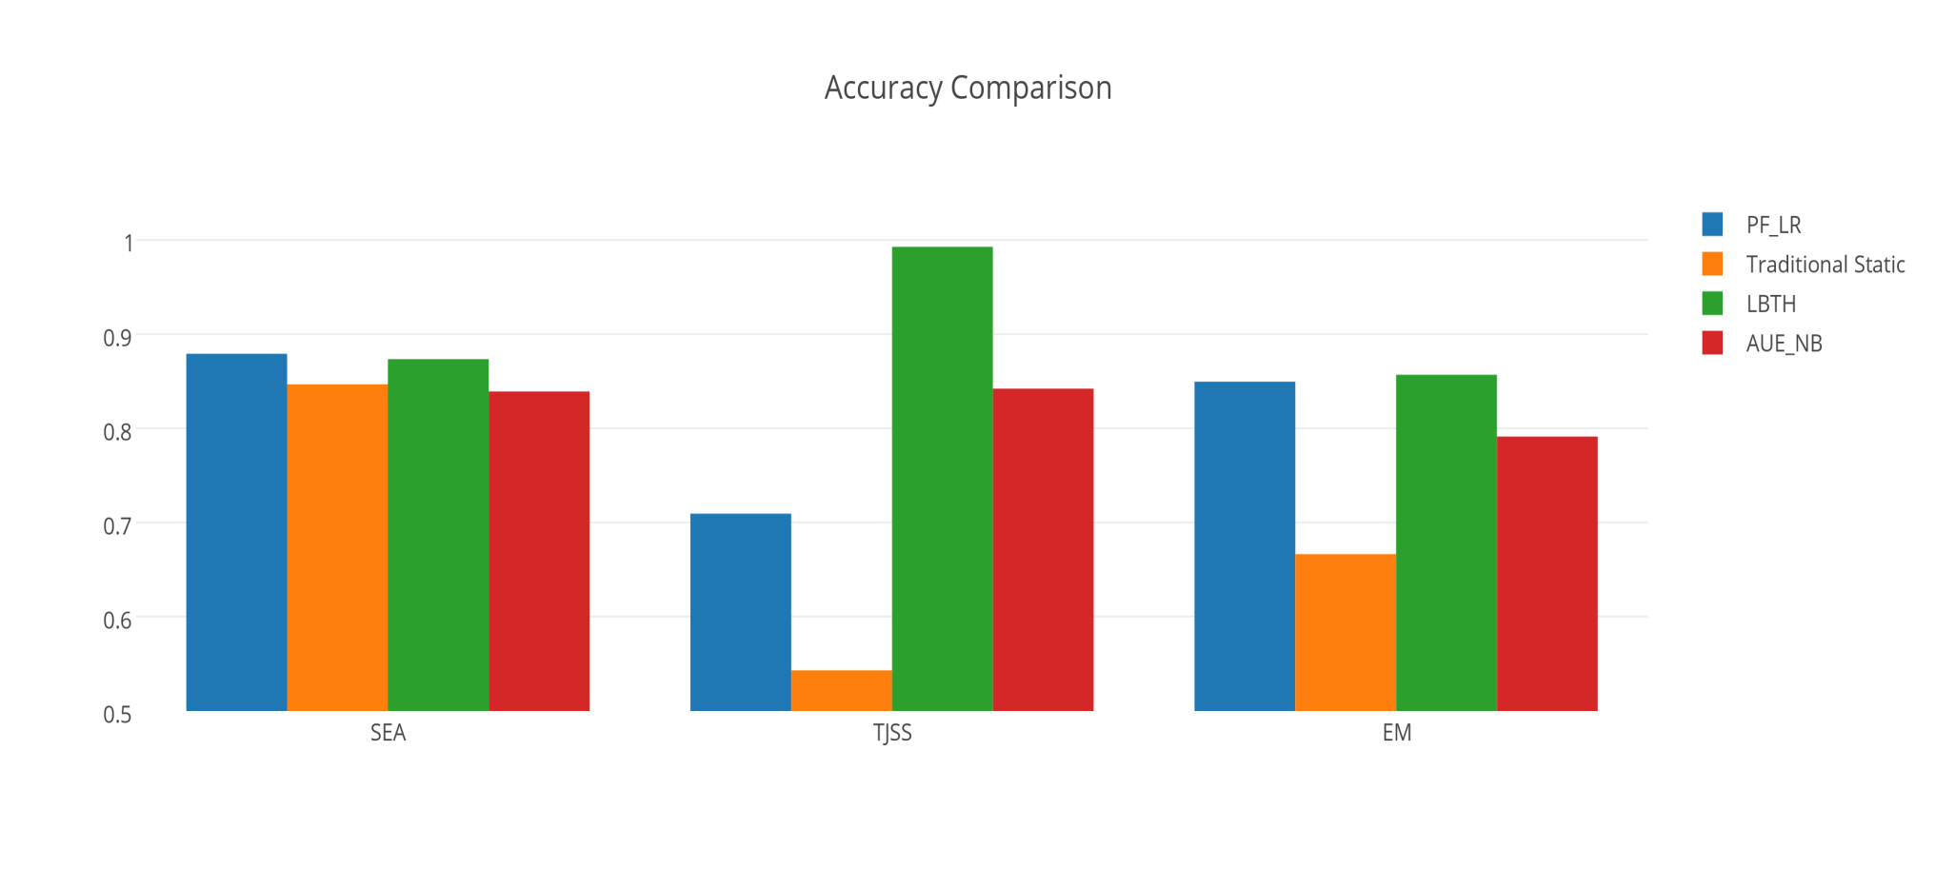
Experimentation : Results

Slide 21
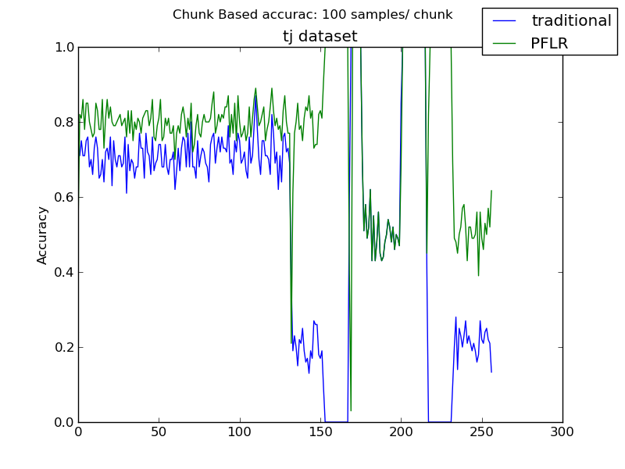
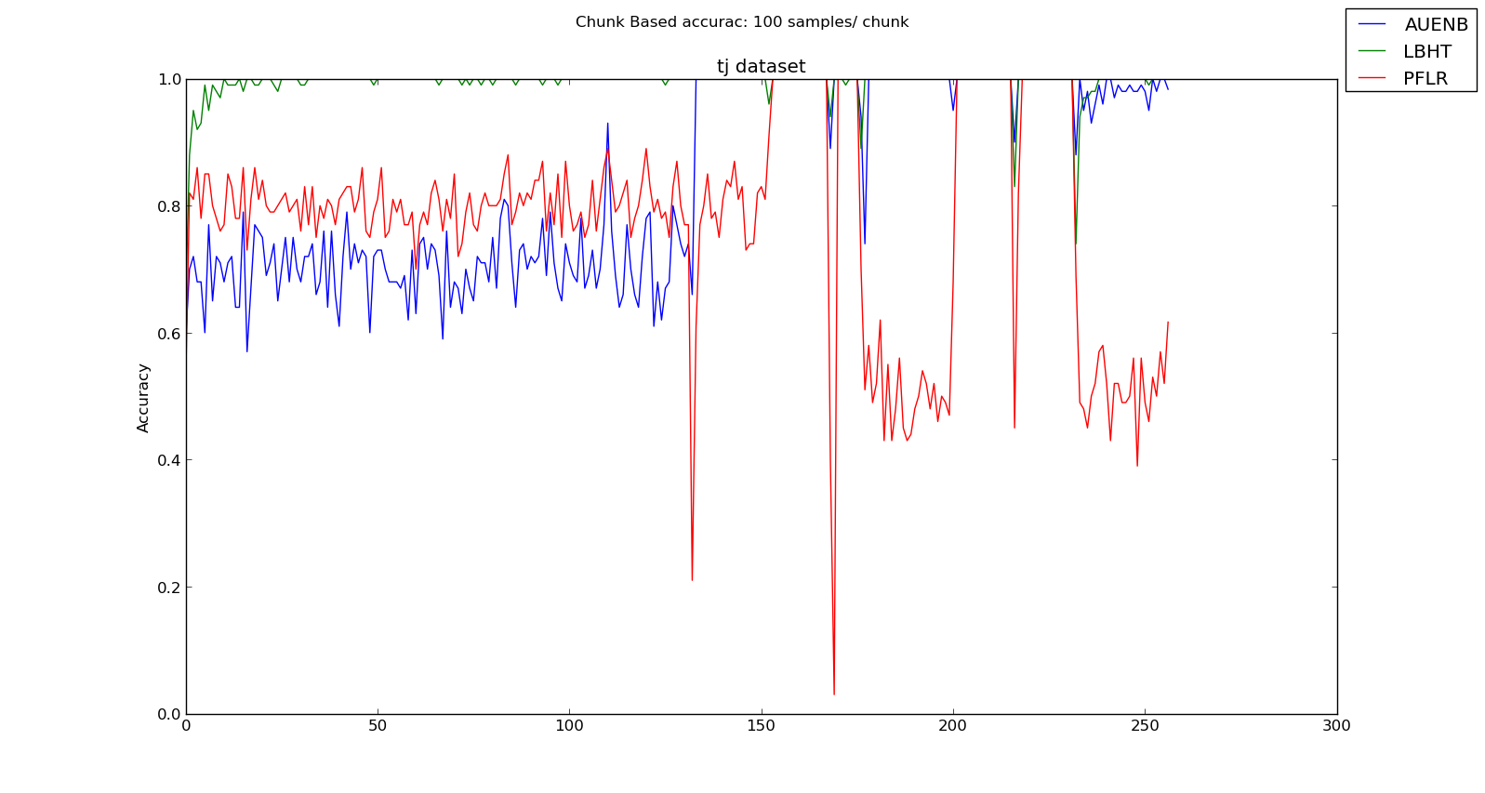
Experimentation : Analysis

Slide 22
Experimentation : Analysis
> TJSS Stream:

Slide 23
Conclusion
PF can handle drifts in streaming data
Good performance on EM stream– Robustness
Difficulty detecting local drifts
Linear time O(MN), no retraining needed

Slide 24


Slide 25

https://github.com/tegjyotsingh/Incremental-Classification

